Slide 1

The Machine Learning Process
How do I avoid a SettingWithCopyWarning in pandas?
Dr. Reza Dibaj

Slide 2
Avoid a SettingWithCopyWarning
Normally, facing a SettingWithCopyWarning makes developers to turn it off, which is not a good practice.
We consider two scenarios and will find appropriate solutions for them.

Slide 3
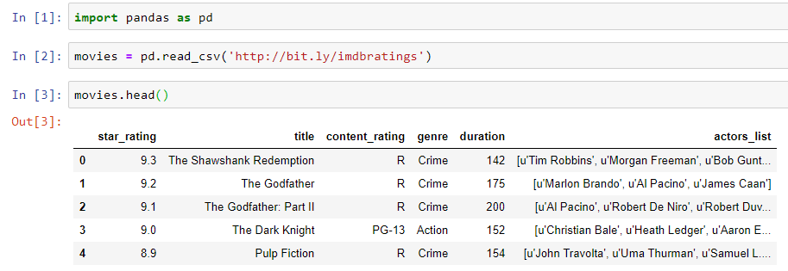
Avoid a SettingWithCopyWarning
Let’s pull up a dataset for today….
Notes:
import pandas as pd
movies = pd.read_csv('http://bit.ly/imdbratings’)
movies.head()

Slide 4
Avoid a SettingWithCopyWarning
Scenario #01

Slide 5
Avoid a SettingWithCopyWarning
We focus on content_rating column, looking for its missing values:

Slide 6
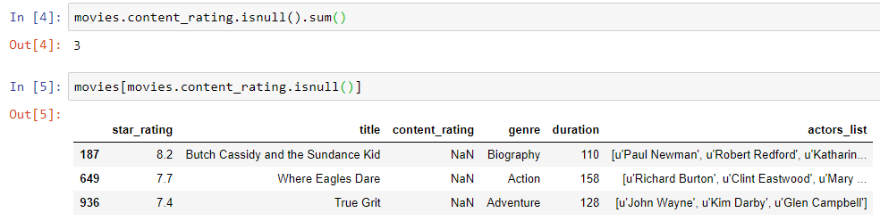
Avoid a SettingWithCopyWarning
Here is the number of missing values in the content_rating column, followed by the rows that have these missing values:
Notes:
movies.content_rating.isnull().sum()
movies[movies.content_rating.isnull()]

Slide 7
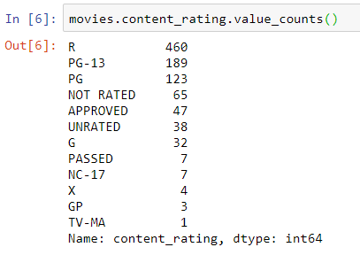
Avoid a SettingWithCopyWarning
Let’s look at the unique values of content_rating:
For the sake of this example, we decide to announce “NOT RATED” values as the missing values in content_rating Series.
That is why we replace them with NaN value to get advantage of missing value functionality.
Notes:
movies.content_rating.value_counts()

Slide 8
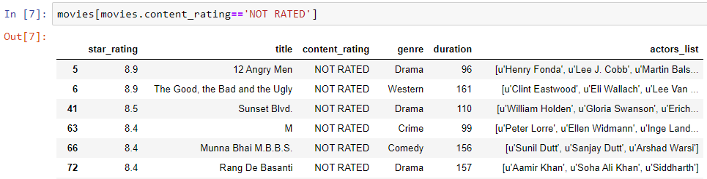
Avoid a SettingWithCopyWarning
Let’s do the job in the following steps:
Step 1: Showing the whole DF that the value of content_rating column is equal to “NOT RATED”.
Notes:
movies[movies.content_rating=='NOT RATED']

Slide 9
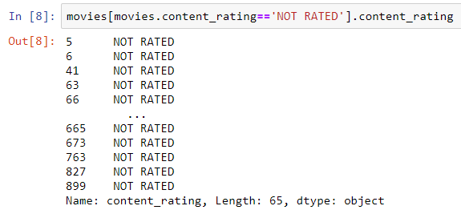
Avoid a SettingWithCopyWarning
Step 2: Now we have only content_rating Series:
Notes:
movies[movies.content_rating=='NOT RATED'].content_rating

Slide 10
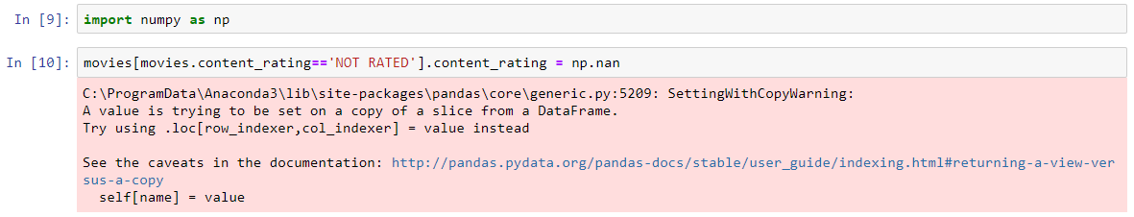
Avoid a SettingWithCopyWarning
Step 3: Overwriting “NOT RATED” with NaN, so we need to import NumPy and run the following commands:
Here is where we get SettingWithCopyWarning.
First, let’s fix it and then see why this happened.
Notes:
import numpy as np
movies[movies.content_rating=='NOT RATED'].content_rating = np.nan

Slide 11


Avoid a SettingWithCopyWarning
First, we check if the previous command applied….
It is still 3, while we expect to see 68.
Can you guess why 68?
Notes:
movies.content_rating.isnull().sum()

Slide 12
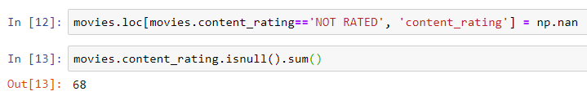
Avoid a SettingWithCopyWarning
Here is the solution to make the code work:
Notes:
movies.loc[movies.content_rating=='NOT RATED', 'content_rating'] = np.nan
movies.content_rating.isnull().sum()
Invented by Mondi:
movies.content_rating.replace('NOT RATED', np.nan, inplace=True)

Slide 13
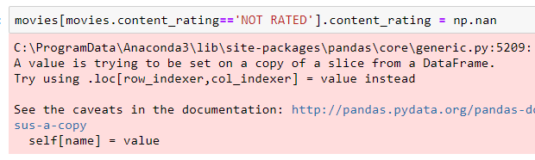
Avoid a SettingWithCopyWarning
The logic is, the first part of the following code is the get part and the second part is the set part.
pandas is not sure if the get part brings a view or a copy, as if it is a view the set would affect on it and if it is a copy, it would not change anything.
Get
Set

Slide 14
Avoid a SettingWithCopyWarning
Loc() solves the problem by turning two operations into a single set item operation:
Summary: If you want to select rows and columns in one command row, use loc().
Notes:
movies.loc[movies.content_rating=='NOT RATED', 'content_rating'] = np.nan
movies.content_rating.isnull().sum()

Slide 15
Avoid a SettingWithCopyWarning
Scenario #02

Slide 16
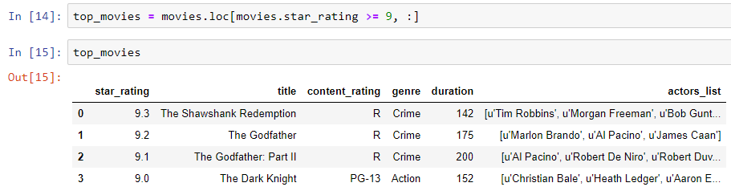
Avoid a SettingWithCopyWarning
We are going to pretend that we only focus on movies with very high star rating. So, we create a separate DF as follows:
Notes:
top_movies = movies.loc[movies.star_rating >= 9, :]
top_movies

Slide 17
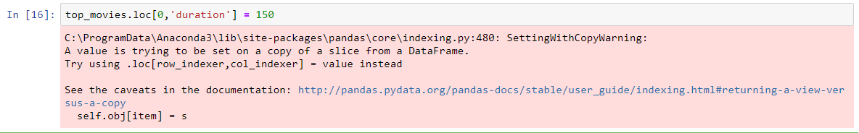

Avoid a SettingWithCopyWarning
Imagine that we notice that the duration for “The Shawshank Redemption” is not correct and we want to fix it.
We run the following command and we receive the following SettingWithCopyWarning:
It is suggested to use .loc() and we have used it. What could be the problem?
Notes:
top_movies.loc[0,'duration'] = 150

Slide 18
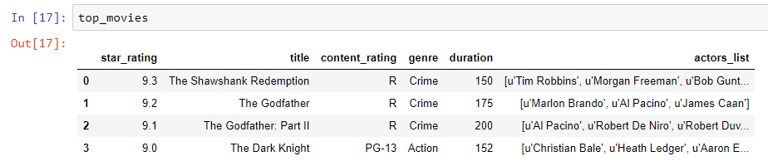
Avoid a SettingWithCopyWarning
Before resolving the warning issue, let’s see if applied the command….
Yes! It actually did!
Notes:
top_movies

Slide 19
Avoid a SettingWithCopyWarning
The reason of warning is pandas is not sure if the top_movies DF is a view or copies of movies DF.
So, it warns us to see if we want to modify one DF or two DFs…
Notes:
top_movies

Slide 20
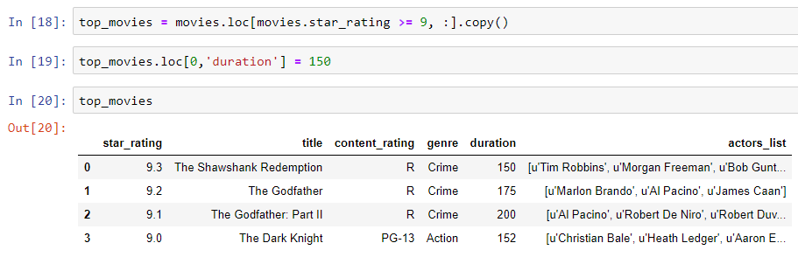
Avoid a SettingWithCopyWarning
The problem has come from this line of code:
Anytime we want to create a DF copy, we should explicitly use .copy() method as follows. In that case pandas can be sure that it is a copy and not a view of four rows of movies DF.
Notes:
top_movies = movies.loc[movies.star_rating >= 9, :].copy()
top_movies.loc[0,'duration'] = 150
top_movies

Slide 21
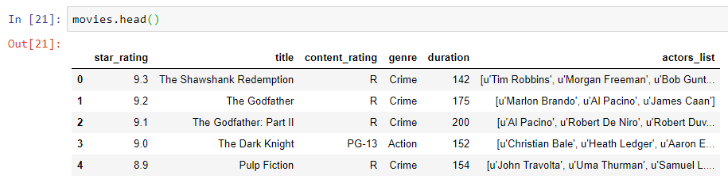
Avoid a SettingWithCopyWarning
And if we check the movies, it did not change.
Notes:
movies.head()

Slide 22

Thank you
Question?
To be
Not to be

